Slide 1


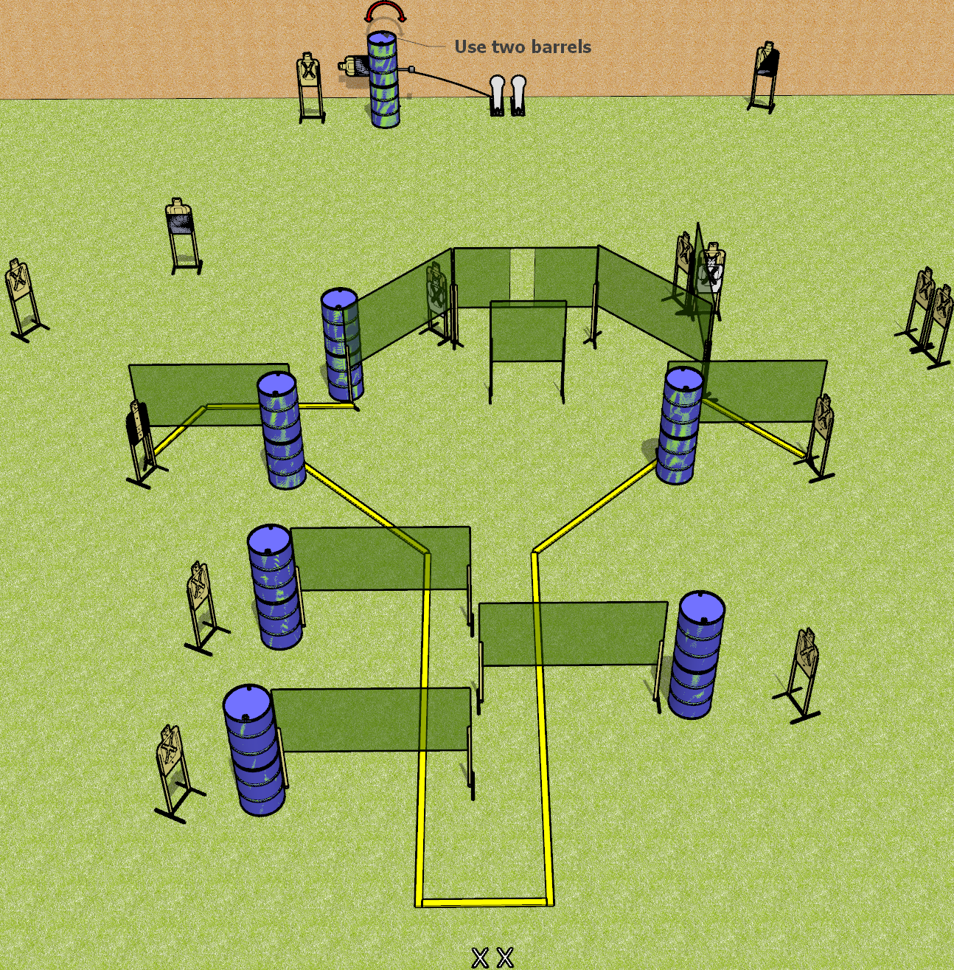
 | Dothan Gun Club – USPSA Match Just do it Course Designer : Drew Coleman
START POSITION : Standing with both feet on X’s, wrists below belt
GUN READY CONDITION : Pistol loaded and holstered. PCC loaded, held with both hands, shouldered, safety on, pointed at orange cone. |  | SCORING: Comstock, 32 rounds TARGETS: 15 paper, 2 Steel SCORED HITS: Best 2 on paper, steel until down START-STOP: Audible, last shot RULES:
STAGE PROCEDURE: Engage targets as they become available from within the fault lines.

Slide 2
Just do it
Written Stage Briefing
Just do it is a 32 round, 160 point, Comstock field course. There are fifteen USPSA targets and two colt poppers. The best two hits on paper will score, and steel must fall to score. The start signal is audible.
Left colt popper activates the swinger. Please check to see how the swinger is set before testing it, and set it the same way every time.
Handgun start position is standing with both feet on X’s, wrists below belt. Handgun is loaded and holstered.
PCC start position is standing with both feet on X’s, muzzle pointed at orange cone. Loaded carbine is held with both hands, shouldered, safety on.
On start signal, engage targets as they become available from within the shooting area.

